Slide 1

JCAPS 5.1 Web Service Client
Phani Krishna

Slide 2
Web service Consumer Scenario
Components Required
  WSDL File
  Connectivity Map
  Java Collaboration
  Deployment Profile
  External Systems

Slide 3
WSDL Path
Path of WSDL File
../JCAPS5.1/uddidocs/environment/project/jcd/wsdl_(…..).wsdl

Slide 4
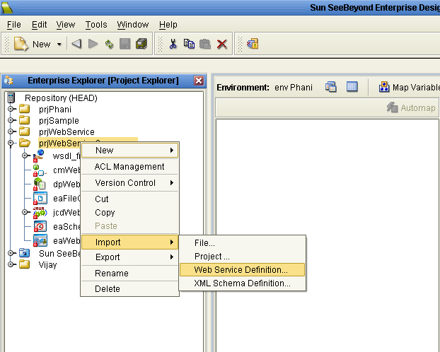
Import WSDL File to the Project

Slide 5
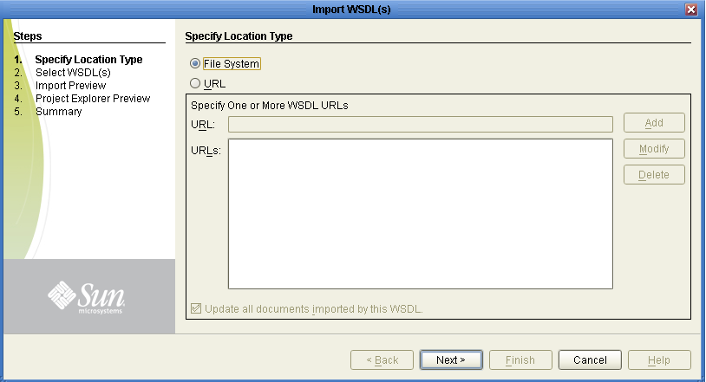
Import WSDL File to the Project(cont)

Slide 6
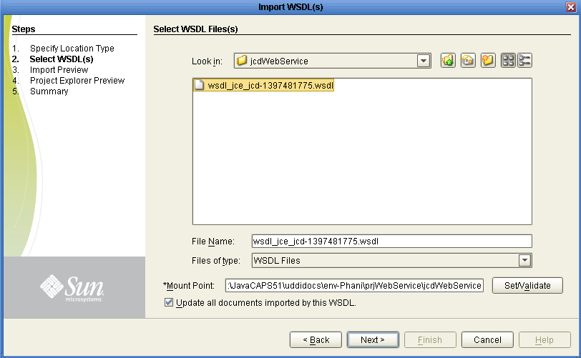
Import WSDL File to the Project(cont)

Slide 7
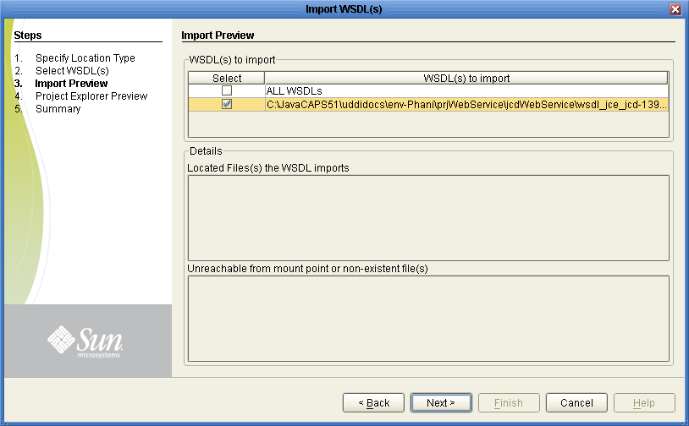
Import WSDL File to the Project(cont)

Slide 8
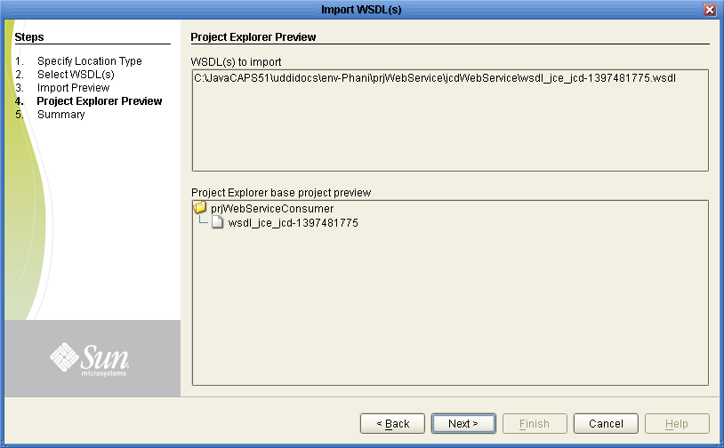
Import WSDL File to the Project(cont)

Slide 9
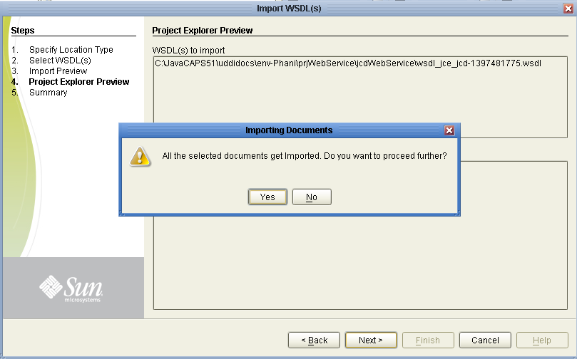
Import WSDL File to the Project(cont)

Slide 10
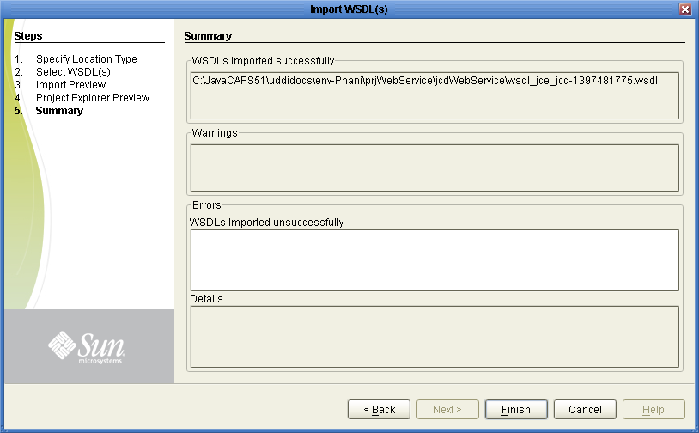
Import WSDL File to the Project(cont)

Slide 11
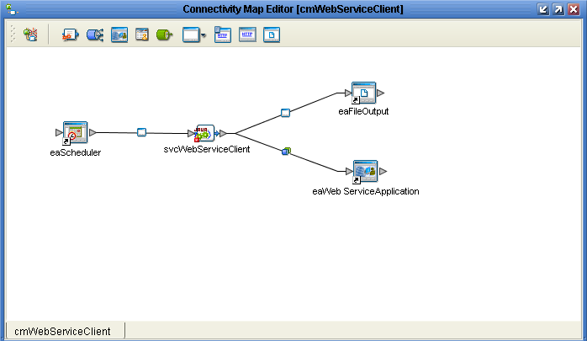
Connectivity Map

Slide 12
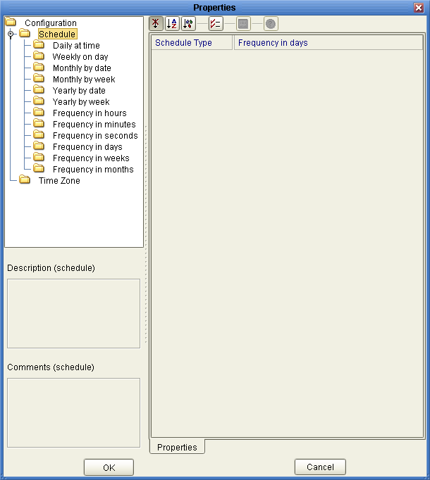
Scheduler Configuration

Slide 13
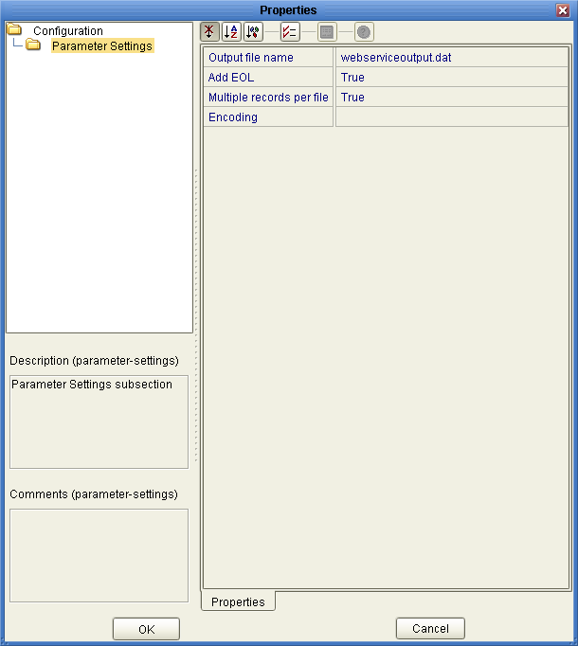
External File Configuration

Slide 14
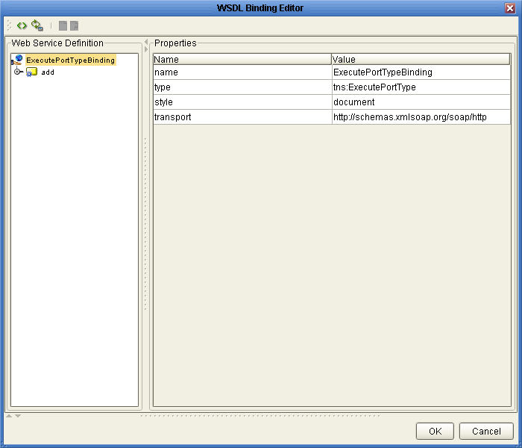
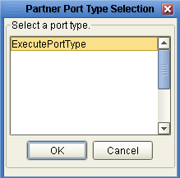
Web Service Configuration Parameter Settings
(svcWebServiceClient-> eaWebService )

Slide 15
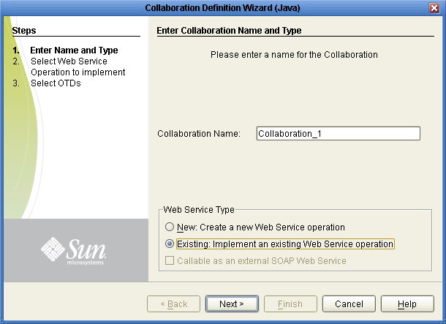
JCD Creation

Slide 16
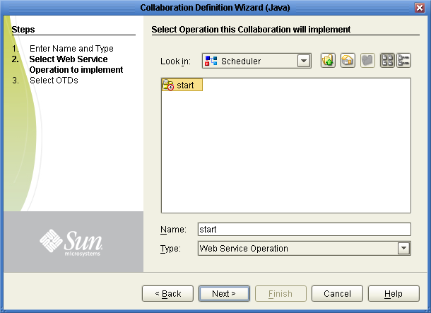
JCD Creation (cont)

Slide 17
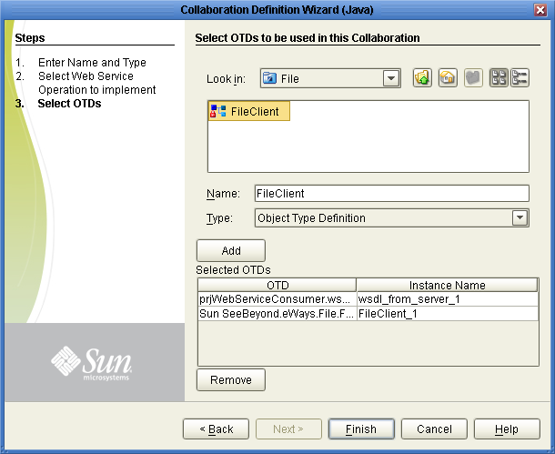
JCD Creation (cont)

Slide 18
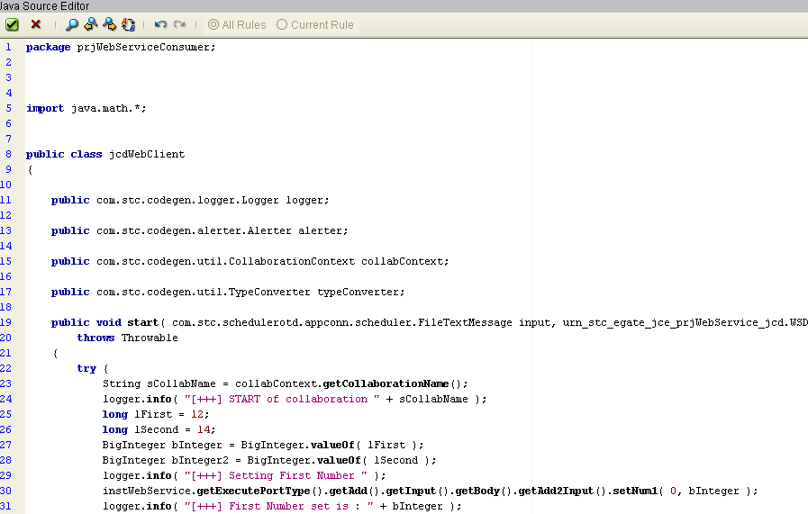
Jcd Code
(svcWebClient)

Slide 19
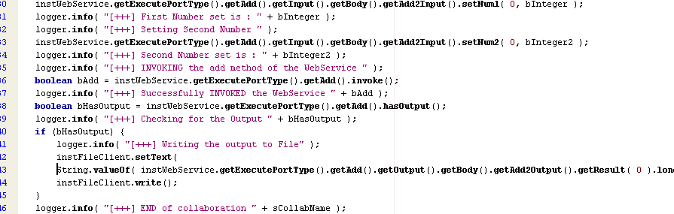
Jcd Code
(svcWebClient - Cont)

Slide 20
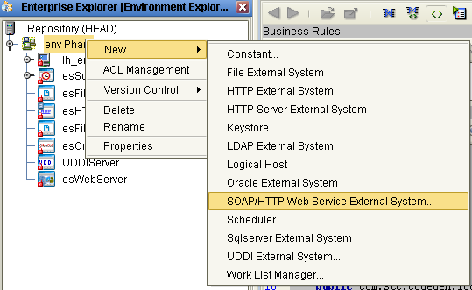
External System
(esWebClient)

Slide 21
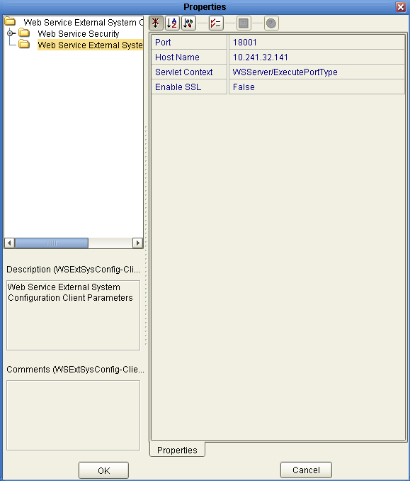
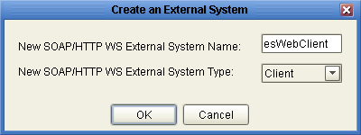
External System Configuration
(esWebClient)

Slide 22
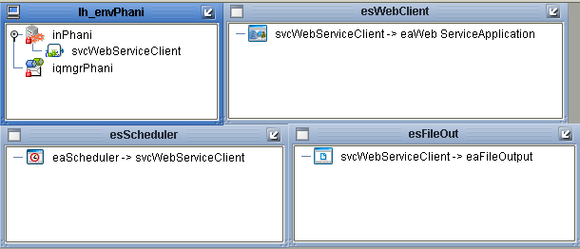
Deployment Profile
(dpWebClient)

Slide 23
Thank You
Phani Krishna

